Slide 1
Testing in Agile Model
Using Scrum method

Slide 2
Overview
  Content
  Key Features of Scrum Methodology
  3 Pillars of scrum
  Role of Tester in Scrum
  Testing Activities in Scrum
  Test Reporting

Slide 3
Key Features of Scrum Methodology
Sprints
meetings, events, and milestones
stories

Slide 4
3 Pillars of Scrum
Roles
  Product Owner Scrum Master Team
Artifacts
  Product Backlog Sprint Backlog Burn-Down Charts
Ceremonies
  Sprint Planning Sprint Review Sprint Retrospect Daily Scrum Meeting

Slide 5
Role of Tester in Scrum
no active role
Unit Testing done by developer
Product Owner involved in testing
Dedicated testing team on basis of project complexity

Slide 6
Testing Activities in Scrum
During
Sprint Planning
Sprint
Sprint Retrospective

Slide 7
Sprint Planning
Tester
should pick a user-story from the product backlog that should be tested.
Perform Effort Estimation for testing selected user stories
must know what sprint goals are.
contribute to the prioritizing process

Slide 8
Sprint
Support developers in unit testing
Test user-story when completed.
attends all daily standup meeting to speak up
puts backlog items not completed to the next sprint
responsible for developing automation scripts.
Review CI automation results and send Reports to the stakeholders
Executing non-functional testing for approved user stories
Coordinate with customer and product owner to define acceptance criteria for Acceptance Tests
At sprint end, might do acceptance testing(UAT) and confirms testing completeness for the current sprint

Slide 9
Sprint Retrospective
figure out what went wrong and what went right
identifies lessons learned and best practices

Slide 10
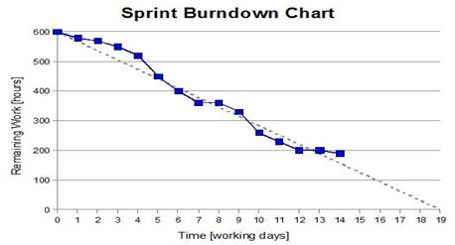
Test Reporting
Burn down chart
Velocity History Graph
Additional metrics:Schedule burn, budget burn, theme percent complete, stories completed - stories remaining and so on.

Slide 11
Thank You

